Slide 1
Automatic Attendence System
CVDL Innovative Assignment
Prepared By
23BCE515 – Harshil Jetani
23BCE517 - Akshat Jingar
23BCE535 – Keval Shah

Slide 2
Introduction
In educational institutions, maintaining attendance records accurately and efficiently is crucial for monitoring student participation.
Traditional methods of roll call or card-based systems are time-consuming and prone to human error.
Biometric systems, particularly facial recognition, offer an innovative solution to streamline the attendance process by capturing and recognizing faces from images or live feeds automatically.

Slide 3
Manual roll call or sign-in processes can take significant time, especially in large classrooms or events, reducing time available for teaching or other activities.
Human error is common in manual attendance, such as missed names, incorrect entries, or miscounts, leading to inaccurate records.
Traditional systems are vulnerable to proxy attendance, where students or employees can mark attendance for absent peers, undermining accuracy and accountability.
Maintaining paper-based records requires physical storage, is prone to damage, and can be tedious to organize, retrieve, and analyze for long-term records
Problem

Slide 4
Solution
We have used a combination of MTCNN (Multi-task Cascaded Convolutional Networks) for face detection and FaceNet for generating face embeddings was used.
MTCNN is a deep learning model that performs face detection with high accuracy, even in crowded scenes and low-resolution images.
FaceNet is used for creating face embeddings -unique vector representations of faces - enabling accurate face comparison.

Slide 5
MTCNN vs YOLO:
MTCNN outperforms YOLO in detecting multiple faces in group photos, handling occlusions and overlapping faces better.
YOLO struggles with crowded scenes, often missing faces or detecting them incorrectly, especially when faces are close together.
MTCNN is more reliable in varied environments (e.g., classrooms or events) where faces may not be fully visible or evenly lit.
FaceNet for Embedding Generation :
FaceNet creates high-quality embeddings that remain consistent even under lighting and angle variations, making it ideal for attendance systems.
WHY this Solution ?

Slide 6
Event Management: Managing attendee presence in large events.
MTCNN
MTCNN, or Multi-task Cascaded Convolutional Neural Network, is a deep learning-based architecture widely used for face detection and alignment.
Key Components of MTCNN :
Bounding Box Regression : This component adjusts the bounding box coordinates at each stage to progressively localize faces better.
Non-Maximum Suppression (NMS) : NMS is used after each network to eliminate highly overlapping bounding boxes. This reduces redundancy and improves detection precision.
Facial Landmark Prediction : In the last stage, the O-Net also outputs five key facial landmarks (two eyes, nose, and two mouth corners) to help align and recognize faces accurately.

Slide 7
The FaceNet architecture is designed to learn compact, discriminative embeddings for faces, allowing accurate facial recognition and clustering.
Key Components of FaceNet :
Backbone Network (Inception/Inception-ResNet) : This deep convolutional network extracts high-level features from face images, using multiple filters and residual connections to capture detailed facial characteristics efficiently.
Triplet Loss : This loss function trains the model to minimize the distance between embeddings of the same person (anchor and positive) while maximizing the distance from a different person (negative), creating a well-separated embedding space.
FaceNet

Slide 8
Data Preprocessing and Augmentation
Face Alignment : Before passing images through the model, FaceNet typically aligns faces by detecting landmarks (e.g., eyes, nose, mouth) to ensure consistency.
Data Augmentation : Variations in pose, lighting, and occlusions are introduced during training to improve the model’s robustness across diverse conditions.
Post-Processing : After generating embeddings, FaceNet uses Euclidean distance to compare embeddings for face verification (same person or not). For face clustering, it groups similar embeddings using algorithms like k-means, effectively identifying and organizing faces into distinct clusters.
FaceNet

Slide 9
To enhance model robustness and improve recognition accuracy, several data augmentation techniques were applied using Augmentor.
Horizontal Flipping: Creates mirrored images, allowing the model to recognize facial features from different orientations.
Brightness Adjustment: Simulates a range of lighting conditions, helping the model detect faces accurately even when lighting is inconsistent.
Rotation: Rotates images slightly to account for natural head tilts, improving the model's ability to recognize faces from varied angles.
Scaling: Adjusts image size, making the model capable of detecting faces at different distances and sizes in group photos.
Data augementation using augmentor

Slide 10
Event Management: Managing attendee presence in large events.
Applications
Educational Institutions: Automated attendance tracking in classrooms.
Security Systems: Attendance verification for restricted access areas or events.
Corporate Settings: Employee attendance and access control.
Event Management: Managing attendee presence in large events.

Slide 11
The dataset initially contained 65 images, with only 23 labeled images collected. This limited amount of labeled data posed a challenge for achieving high model accuracy, as deep learning models generally require large and diverse datasets for effective training.
To address this, data augmentation techniques were applied to expand the dataset artificially. The augmentation methods included :
Horizontal Flipping : To increase the variability of face orientations.
Scaling : To adapt the model to detect faces at different sizes and distances.
Brightness Adjustment : To simulate different lighting conditions.
Dataset Description

Slide 12
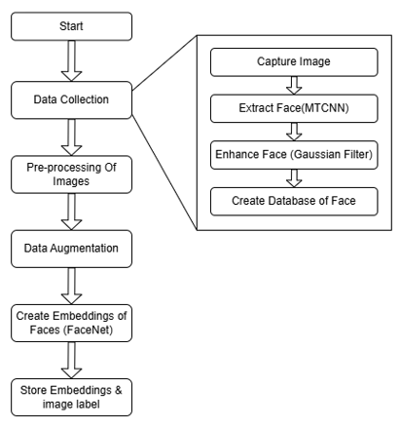
Solution
Images are collected in group photos since it is not possible to capture each student's face individually.
MTCNN is used to detect and extract faces from the group photo.
Gaussian filters are applied to enhance image quality, improving recognition accuracy in low-resolution images.
The extracted and enhanced face images are stored in a database, along with their labels (student IDs).
Image pre-processing and Data augmentation techniques (e.g., rotation, flipping) are applied to the images to increase the dataset size and improve model generalization.

Slide 13
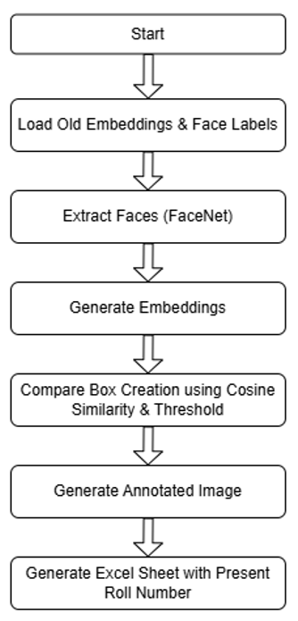
Solution
FaceNet generates embeddings for each face image. These embeddings are vector representations of the facial features, allowing for precise comparisons.
The embeddings and their corresponding labels are stored in a database for easy retrieval during inference.
At inference, the system loads embeddings, detects faces with MTCNN, generates embeddings using FaceNet, compares them with stored embeddings, and annotates the image. It then generates an Excel sheet with the roll numbers of present students.

Slide 14
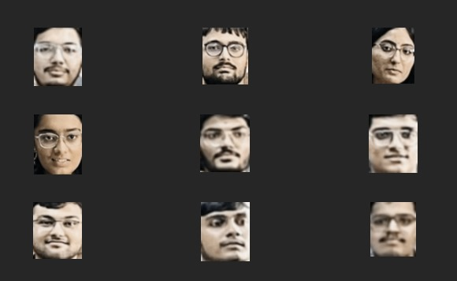
Solution

Slide 15
Dataset Creation :-
Group Photos Instead of Individual Faces: Capturing individual face images was impractical, so group photos were used, which led to difficulties in detecting and extracting multiple faces, especially when they were overlapping or at different angles.
Low-Resolution Faces: Group photos often contained low-resolution faces, which made it harder to generate accurate face embeddings. Gaussian filters were applied to enhance the images, but the challenge remained.
Challenges

Slide 16
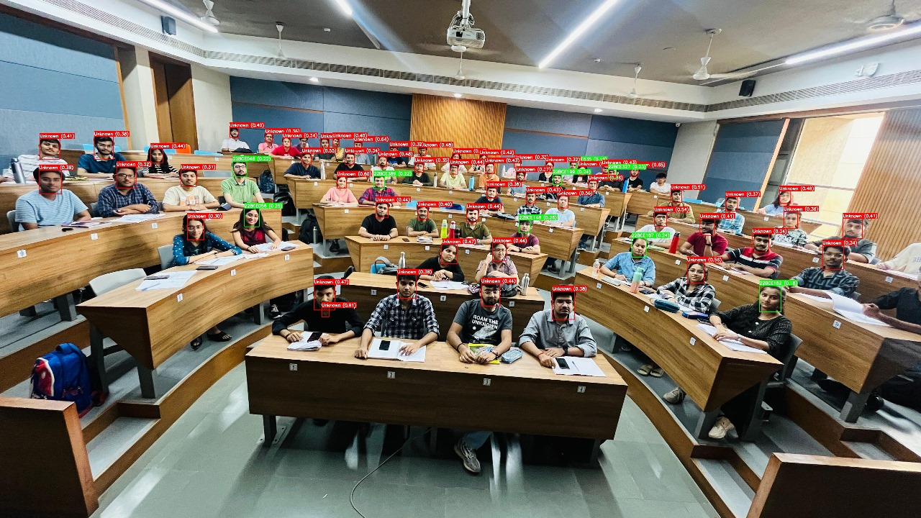
Results
Without Augmentation : The model correctly predicted 9/23 faces, showing limited accuracy due to lack of variability in training data.

Slide 17

Results
With Augmentation: After applying data augmentation techniques, the model's accuracy improved, correctly predicting 14/23 faces.

Slide 18
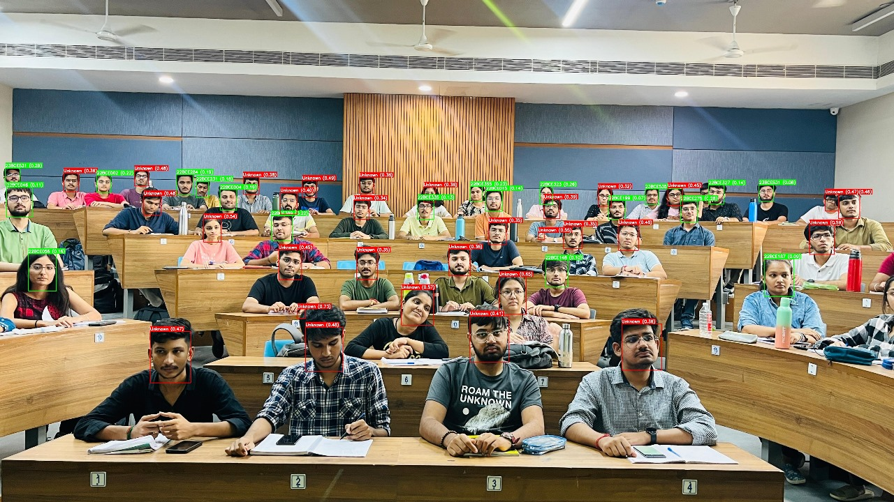
Results
Threshold = 0.3

Slide 19
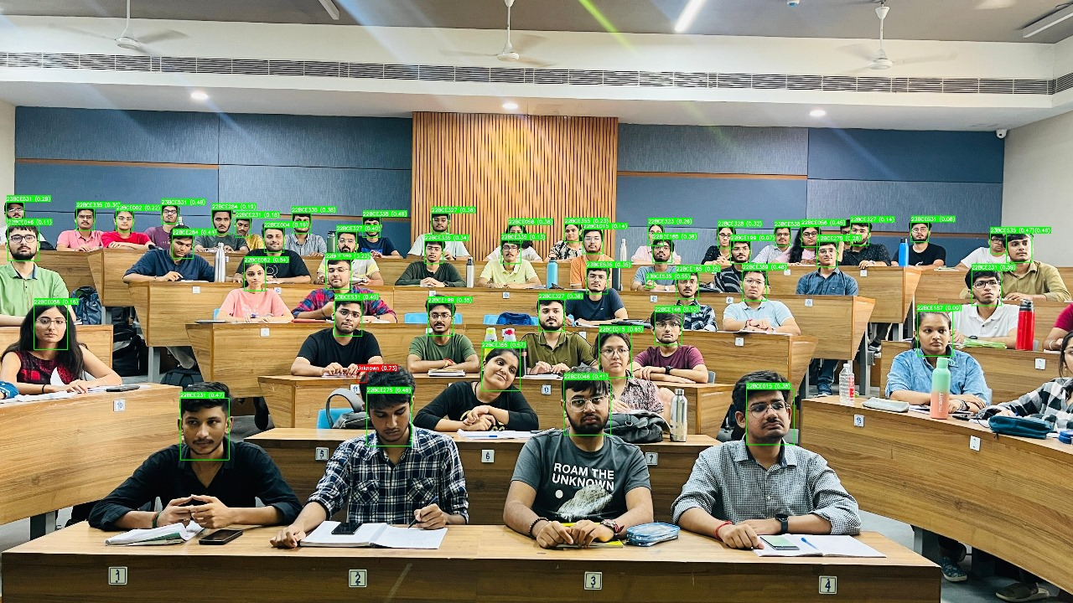
Results
Threshold = 0.76 (More False Detction)

Slide 20
The Face Attendance Recognition System, using MTCNN for detection and FaceNet for embeddings, faced challenges with limited data.
With only 23 labeled images, data augmentation (flipping, scaling, brightness) was applied to improve performance. Switching to MTCNN improved face detection, and FaceNet enhanced matching accuracy.
After augmentation, correct predictions increased from 9 to 14, proving the effectiveness of data augmentation in boosting model performance for real-world attendance tracking.
conclusion

Slide 21
Thank You !!

